Slide 1
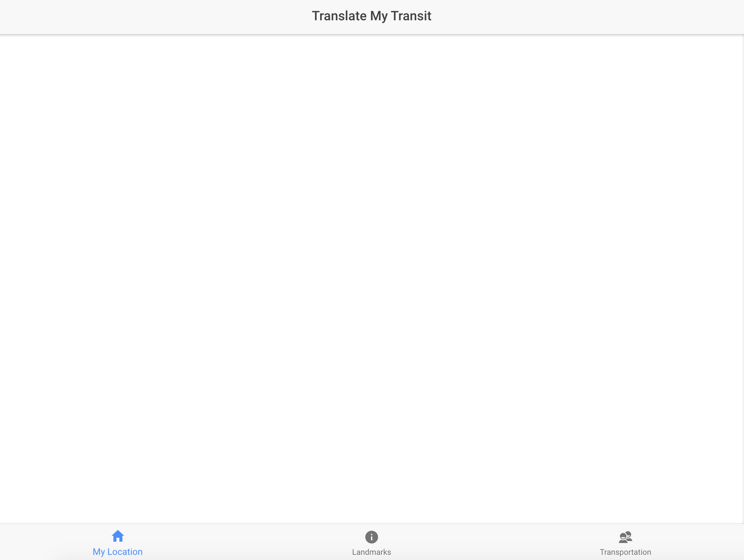

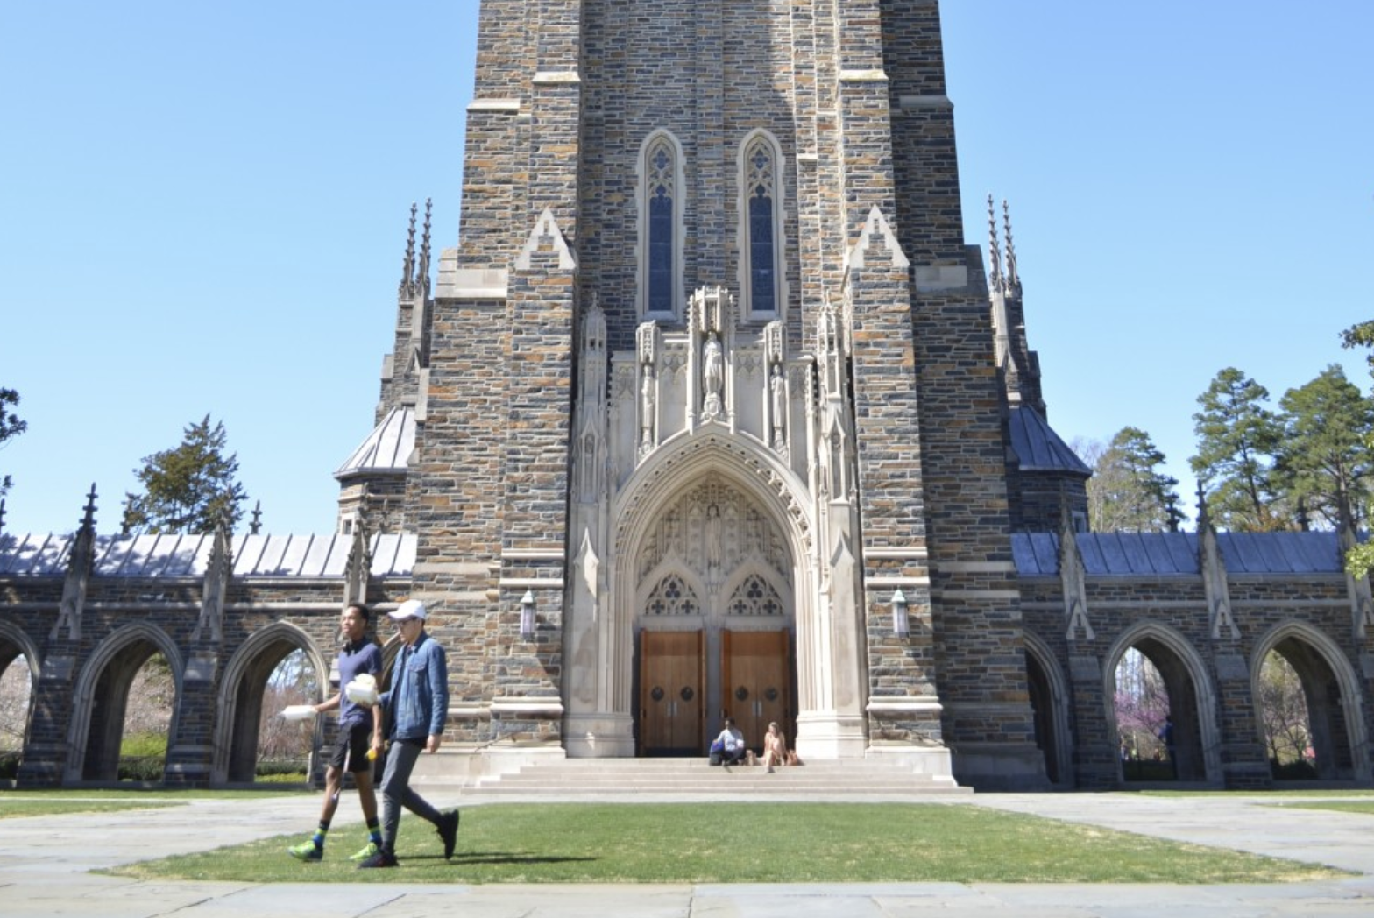

Enter your default location to see how far you are from places on campus.
Select your location:
East
West
Central
Select your dorm:
Enter your dorm name
Craven
Crowell
Few
Kilgo
To end this session (you will be redirected to a feedback survey):
Complete Interaction

Slide 2
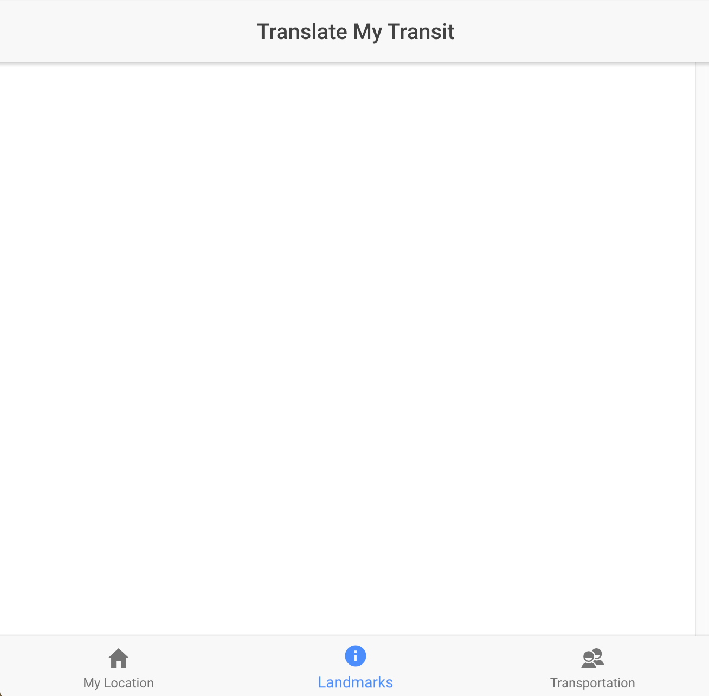
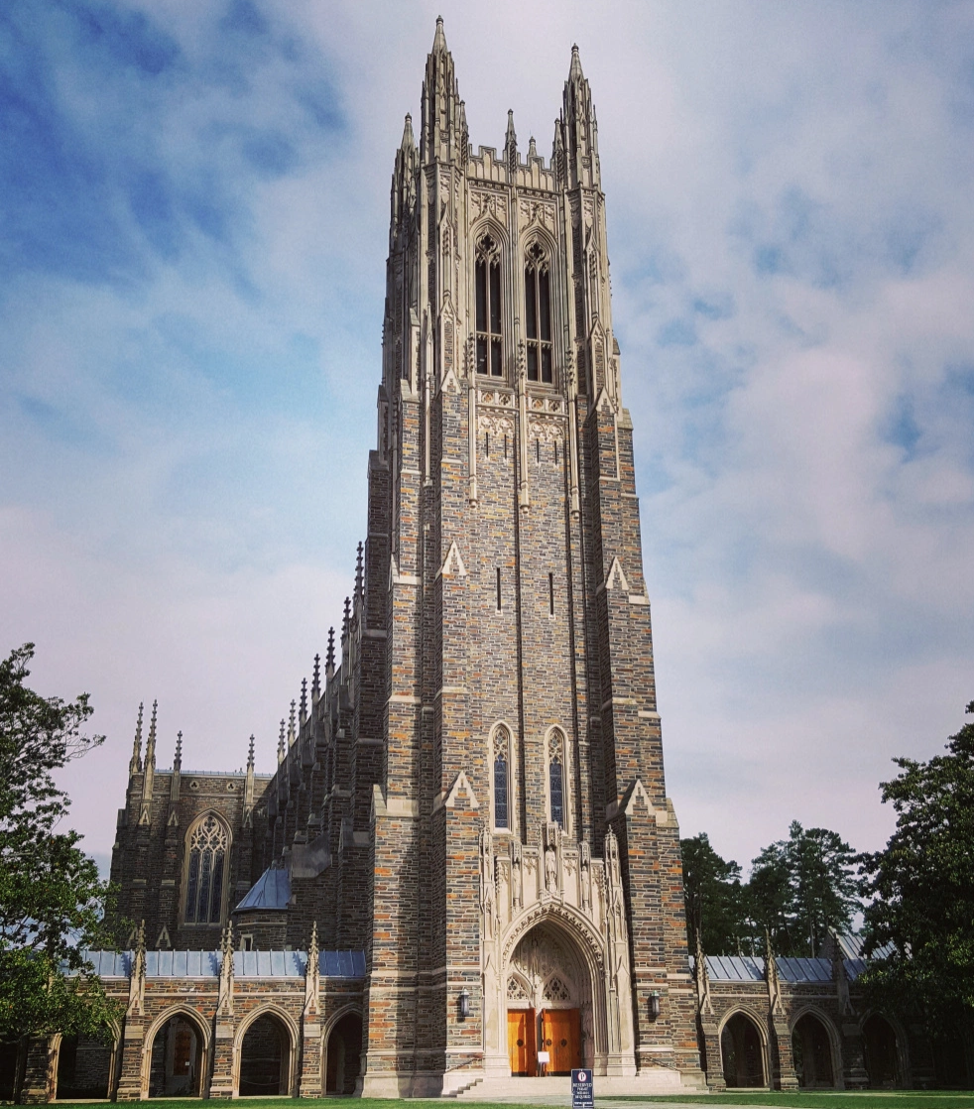
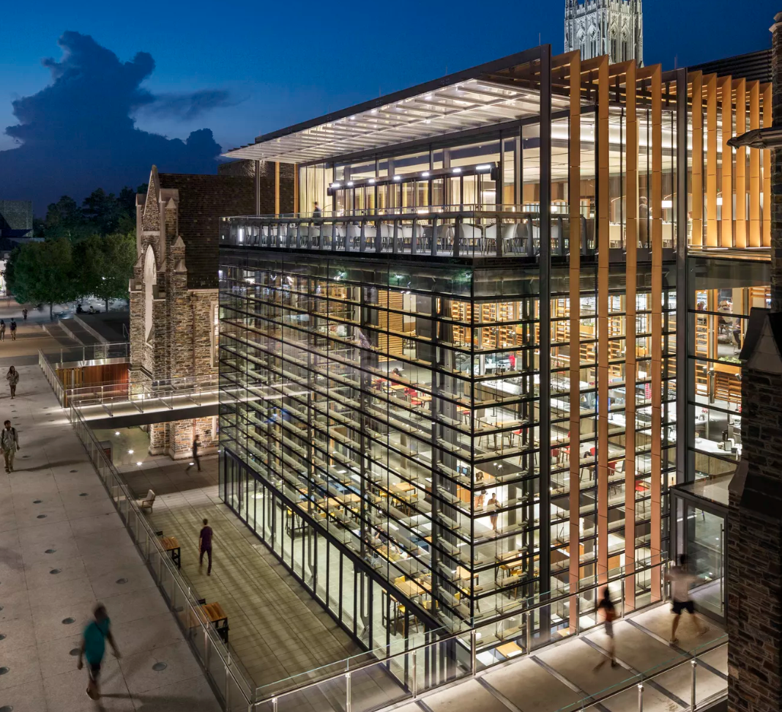

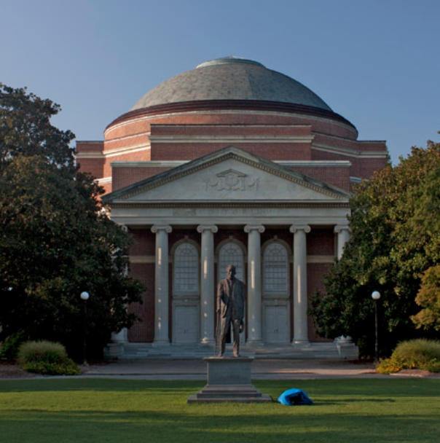
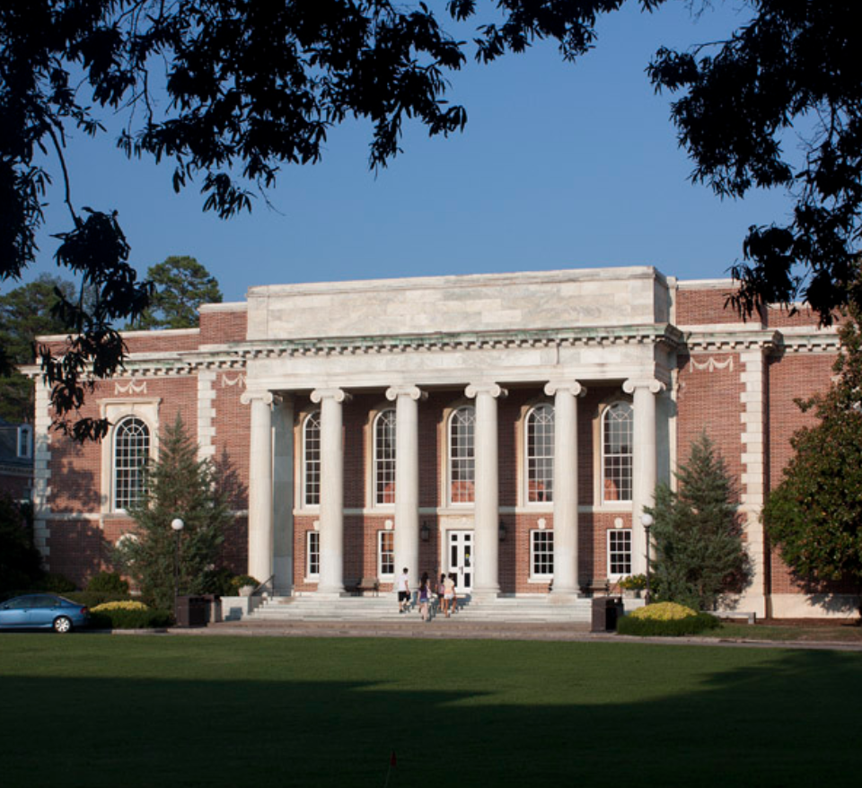
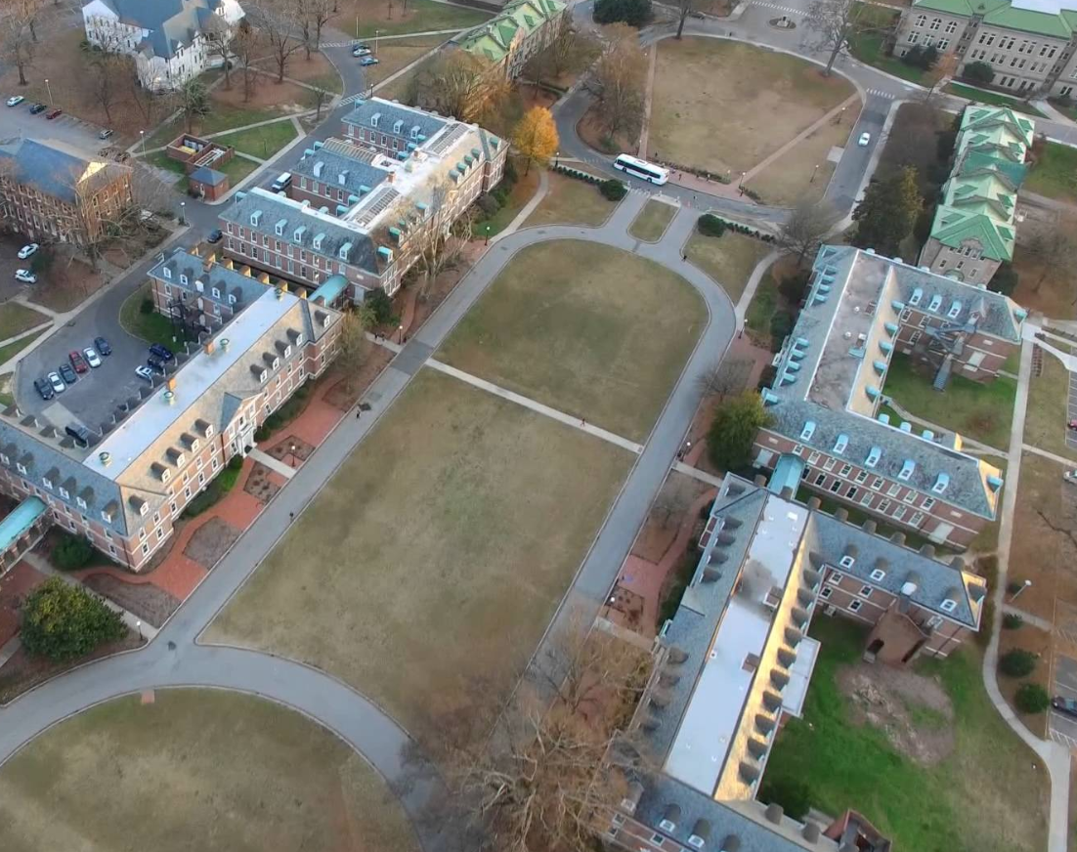
Landmarks
Food/Dining
Residence Halls
Duke Chapel
West Union
West Campus Dorms
mi from me
mi from me
mi from me
Baldwin Auditorium
Marketplace
East Campus Dorms
mi from me
mi from me
mi from me

Slide 3
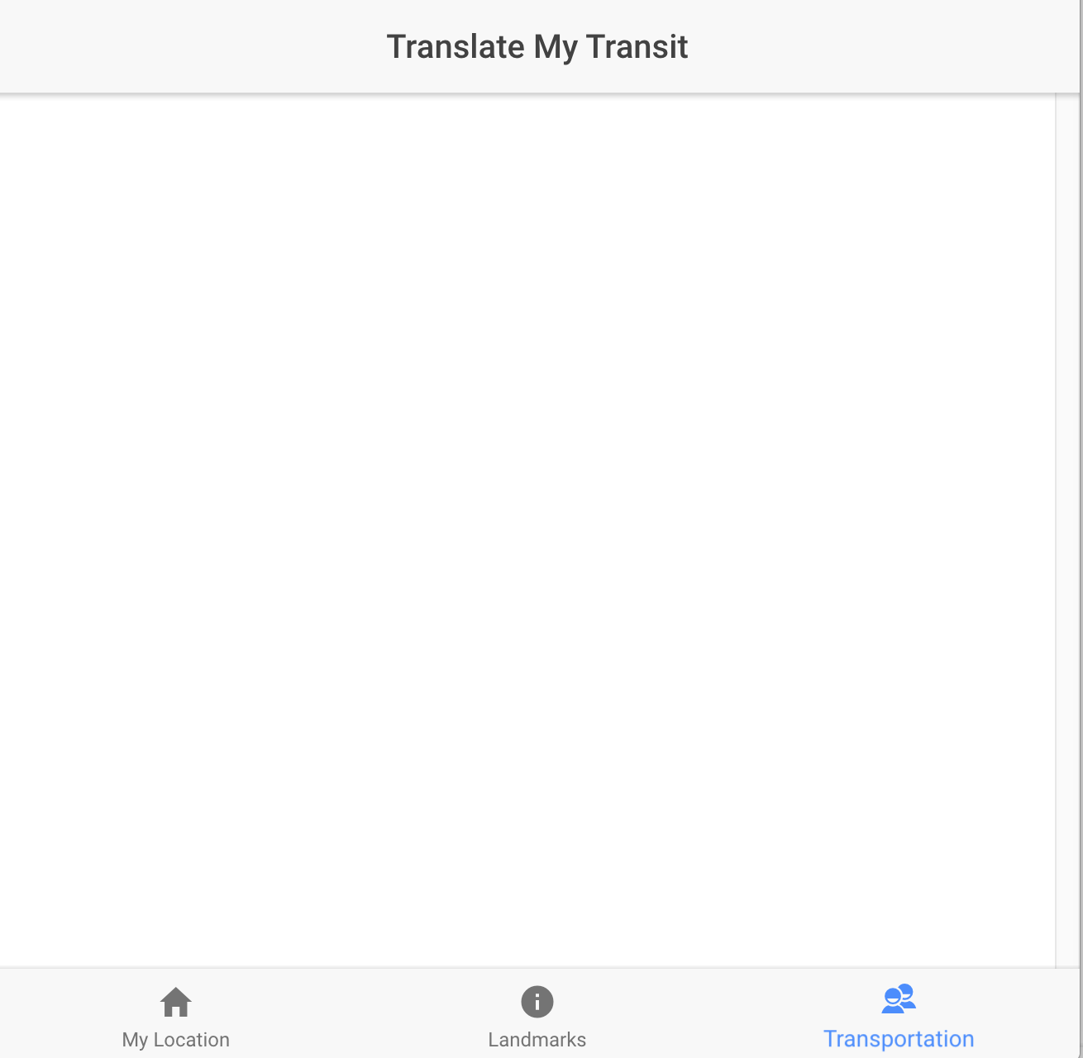
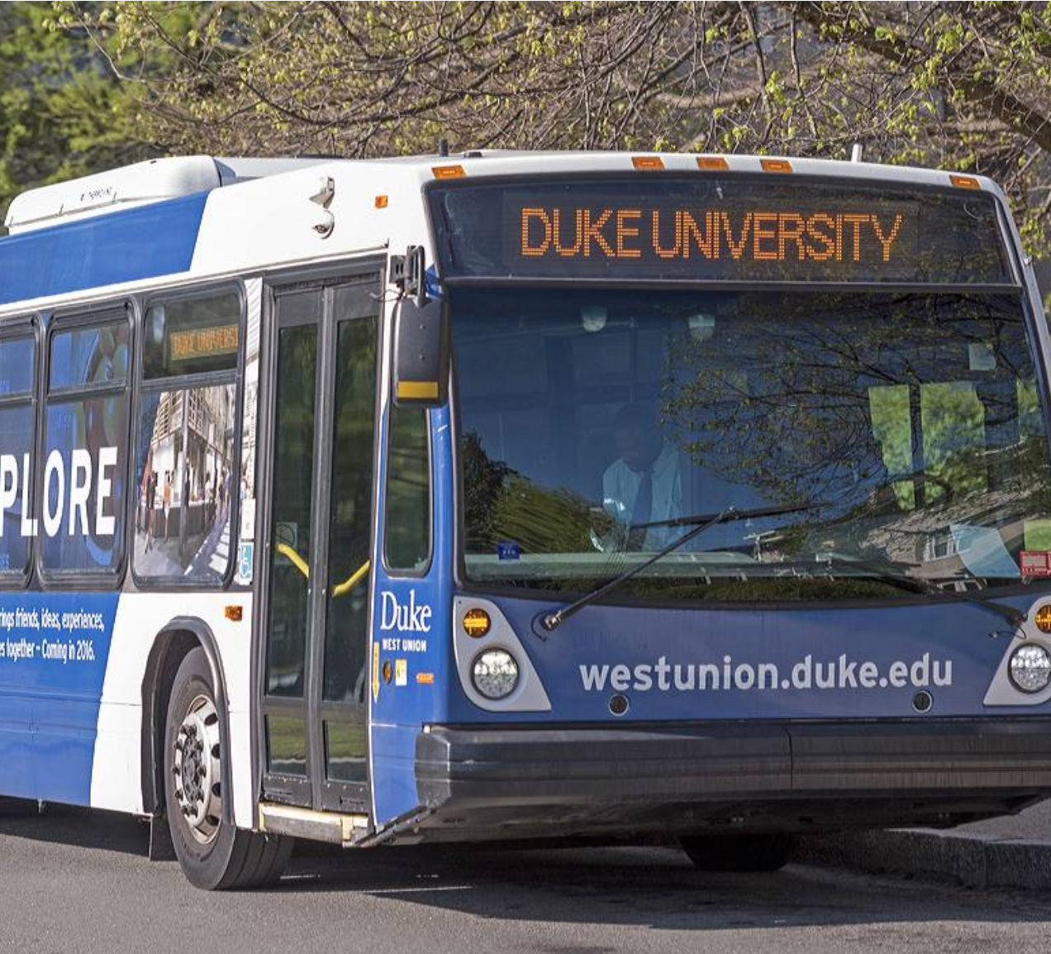
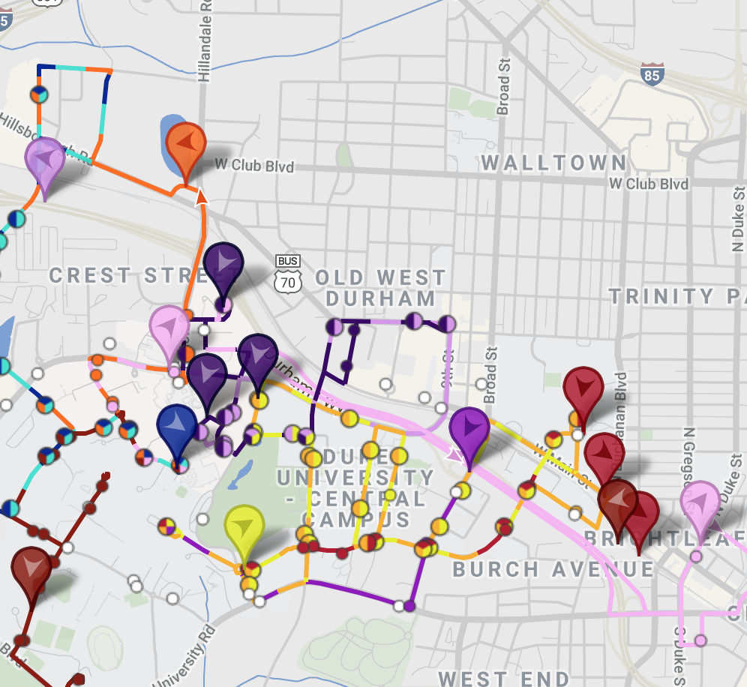
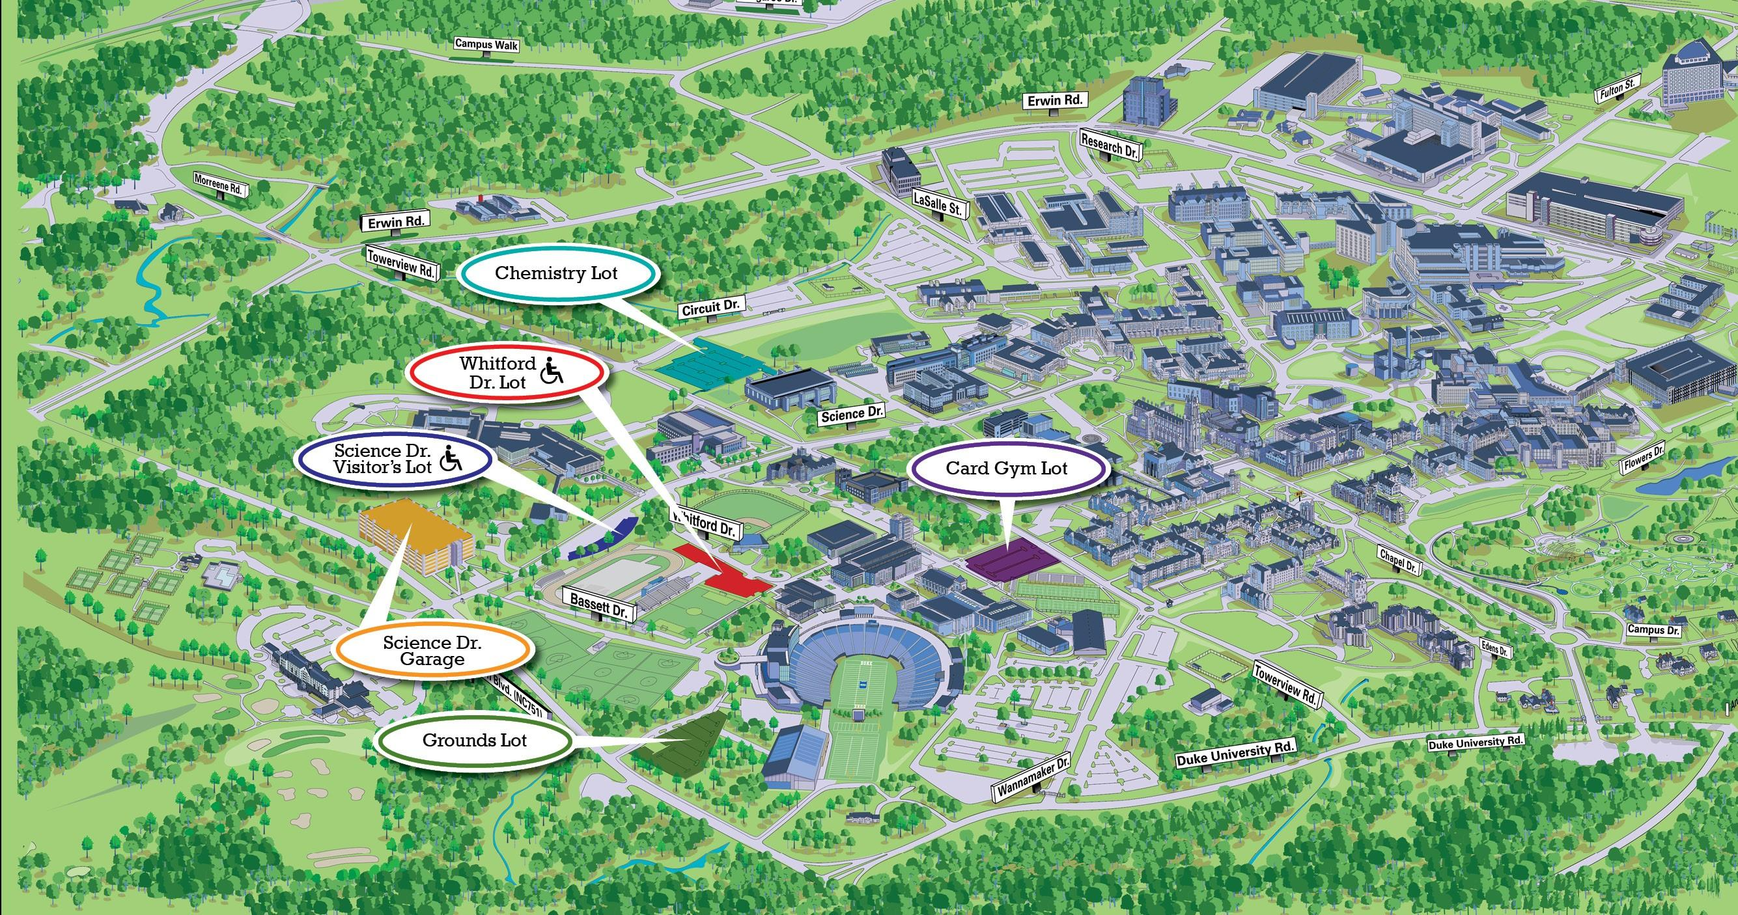
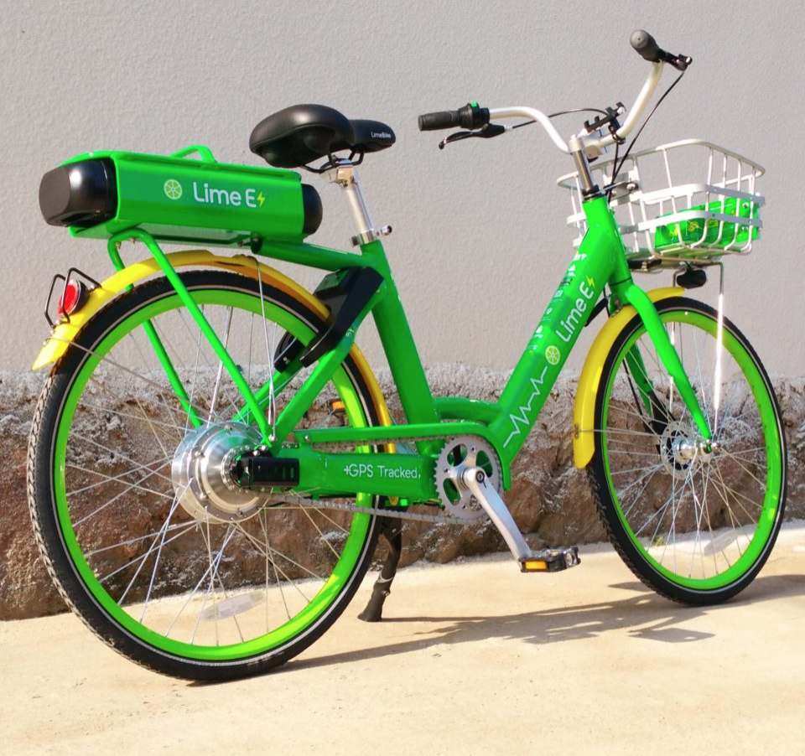
Use these links to learn more about transportation resources available on campus.
Duke Buses
Transloc Bus Tracker
Parking on Campus
LimeBikes

Slide 4
SETTINGS
LANGUAGE SELECTION
Select your primary language:
Select your partner’s primary language:
Your language:
English
Spanish
Chinese (Traditional)
Chinese (Simplified)
Your language:
English
Spanish
Chinese (Traditional)
Chinese (Simplified)
FEEDBACK
If you do not understand the translated text, report an error:
To end this session (you will be redirected to a feedback survey):
Error
Complete Interaction

Slide 5

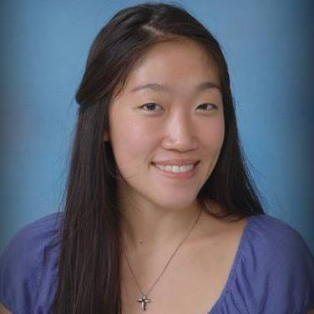

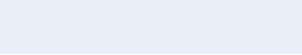

Enter your default location to see how far you are from places on campus.
Select your location:
East
West
Central
MOLLY CHEN
MY LOCATION
Select your dorm:
LANDMARKS
Enter your dorm name
Craven
Crowell
Few
Kilgo
TRANSPORTATION
SETTINGS

Slide 6
Landmarks
Food/Dining
Residence Halls
MOLLY CHEN
MY LOCATION
Duke Chapel
West Union
West Campus Dorms
mi from me
mi from me
mi from me
LANDMARKS
TRANSPORTATION
SETTINGS
Baldwin Auditorium
Marketplace
East Campus Dorms
mi from me
mi from me
mi from me

Slide 7
Use these links to learn more about transportation resources available on campus.
MOLLY CHEN
MY LOCATION
LANDMARKS
Duke Buses
Transloc Bus Tracker
TRANSPORTATION
SETTINGS
Parking on Campus
LimeBikes

Slide 8
SETTINGS
LANGUAGE SELECTION
Select your primary language:
Select your partner’s primary language:
MOLLY CHEN
Your language:
English
Spanish
Chinese (Traditional)
Chinese (Simplified)
Your language:
English
Spanish
Chinese (Traditional)
Chinese (Simplified)
MY LOCATION
LANDMARKS
TRANSPORTATION
SETTINGS
FEEDBACK
If you do not understand the translated text, report an error:
To end this session (you will be redirected to a feedback survey):
Error
Complete Interaction

